Slide 1
Happiness with Mindfulness
Dr Zen Low
28/11/21

Slide 2
Health
WHO def.
“ state of complete physical , mental , social wellbeing and not merely the absence of disease & infirmity “

Slide 3
Relationship
mental
social
physical

Slide 4
Main types of other medical practices
Functional/integrated Medicine
Traditional medicine (Ayuvedic, TCM)
Stress/sleep
Food/Nutrient
Toxins/Environment
Stress
Nutrition
Environment
Energy and elements

Slide 5
Epigenetics
Immune
Digestion
Gut health
Laboratory Inx and thorough history
Energy balance
Chakras/secretions
Chi and meridians/acupuncture points
Thorough history , tongue , pulse diagnosis

Slide 7
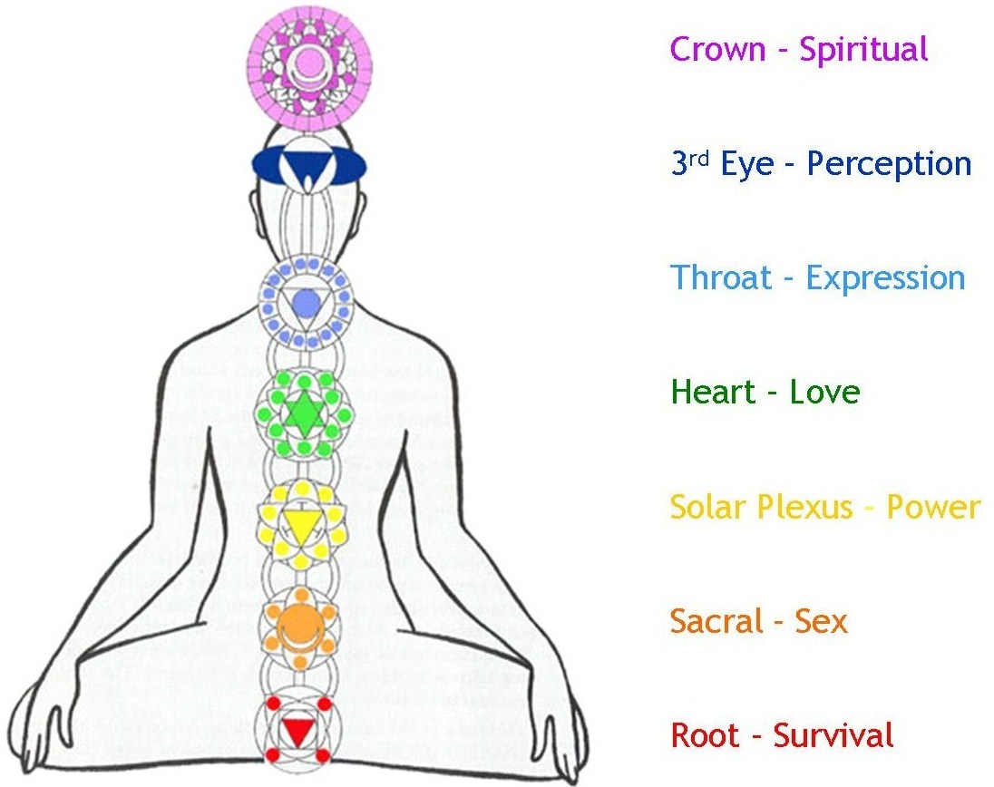
This Photo by Unknown Author is licensed under CC BY

Slide 8
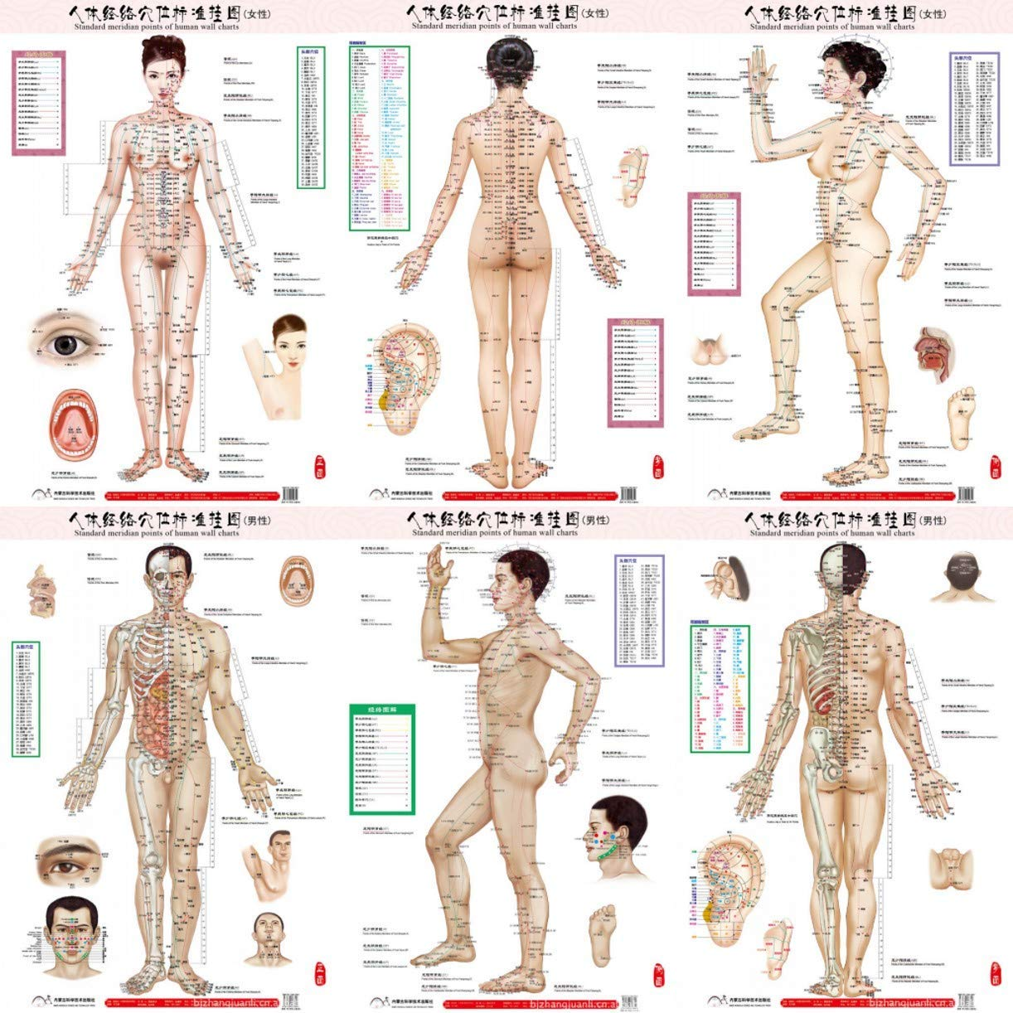
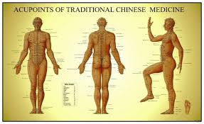

Slide 9
Stress
Def.
Mental , emotional, physical
? Primitive Response for Fight and flight reaction.
Manifest by Stress hormones/ vagus stimulations

Slide 11
Causes of Stress
????

Slide 12
Presentations and Diagnosis
Emotional
Psychological
Physical
social

Slide 13
Treatment
Drugs/supplements
Counselling
Psychotherapy
Yoga/exercise/holidays
Mindfulness meditation

Slide 14
What is Mindfulness meditation?
over 2500 yrs.
Most popular and researched
This practice combines concentration with awareness.
Mainly focus on your breath while you observe any
bodily sensations, thoughts, or feelings.
Easily practiced alone. (1)

Slide 15
Mindfulness meditation
Effects of Mindfulness on Psychological Health: A Review of Empirical Studies
Concluded “ mindfulness brings about various positive psychological effects, including increased subjective well-being, reduced psychological symptoms and emotional reactivity, and improved behavioral regulation.” (2)
1. correlational, cross-sectional research that examines the relations between individual differences in trait or dispositional mindfulness and other mental-health related traits,
2. intervention research that examines the effects of mindfulness-oriented interventions on psychological functioning, and
3. laboratory-based research that examines, experimentally, the effects of brief mindfulness inductions on emotional and behavioral processes indicative of psychological health.

Slide 16
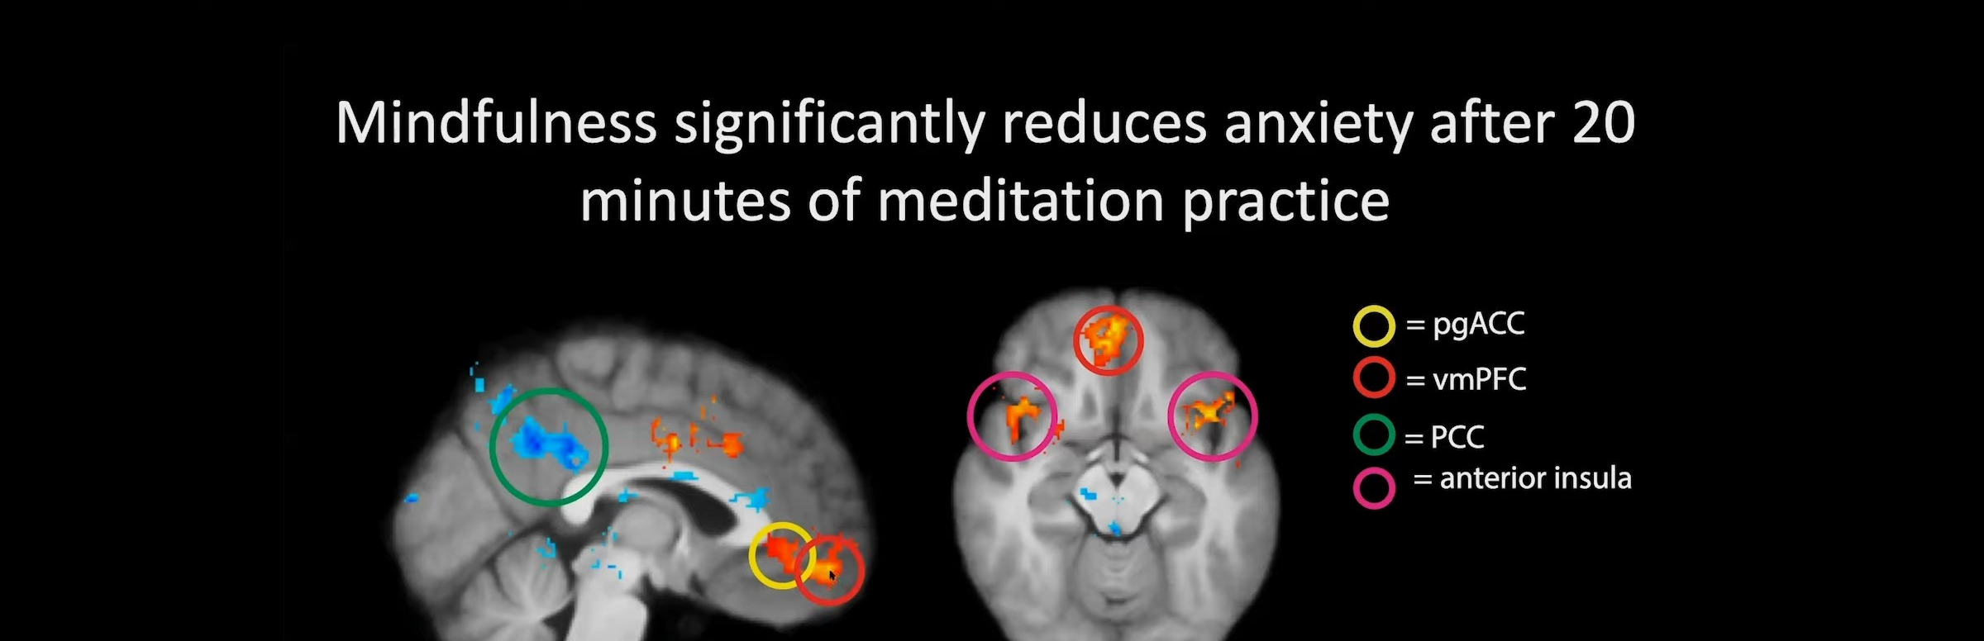
How MM works? With Functional MRI
Increases neural connections between Frontal cortex and the limbic system (3,4)
The Studies MRI and MM and increase the grey matter of the frontal cortex (3,4)
Better control of our stress response

Slide 17
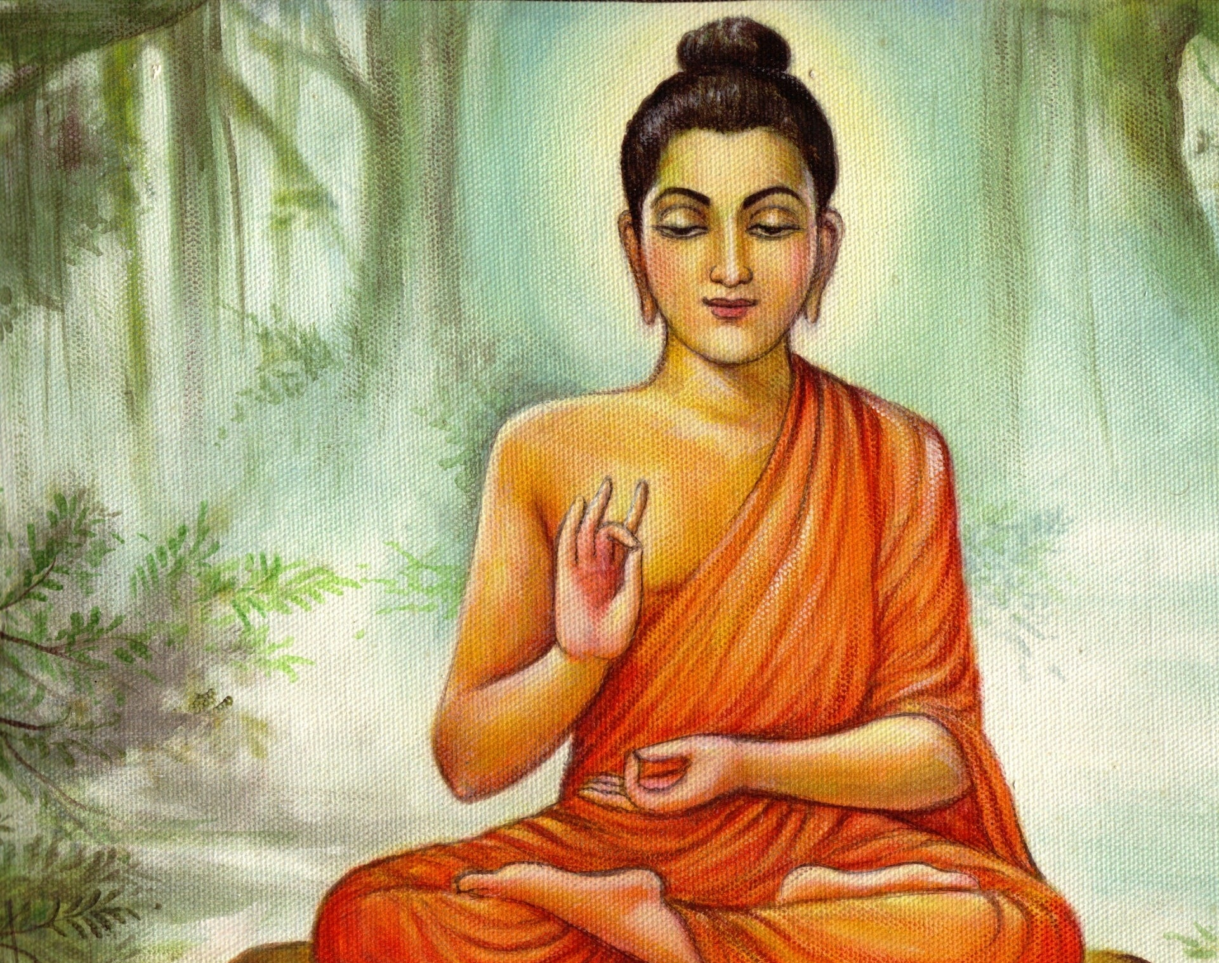
Origin of MM
Buddha use for his Enlightenment ( 4 NT )
1) Stress / sufferings of Life
2) Cause ( origin ) of stress/sufferings
3) Cure for Stress /sufferings
4) Method to practice and achieve
stress free and happiness

Slide 18
Origin of MM ( 8 methods for stress relief )

Slide 19
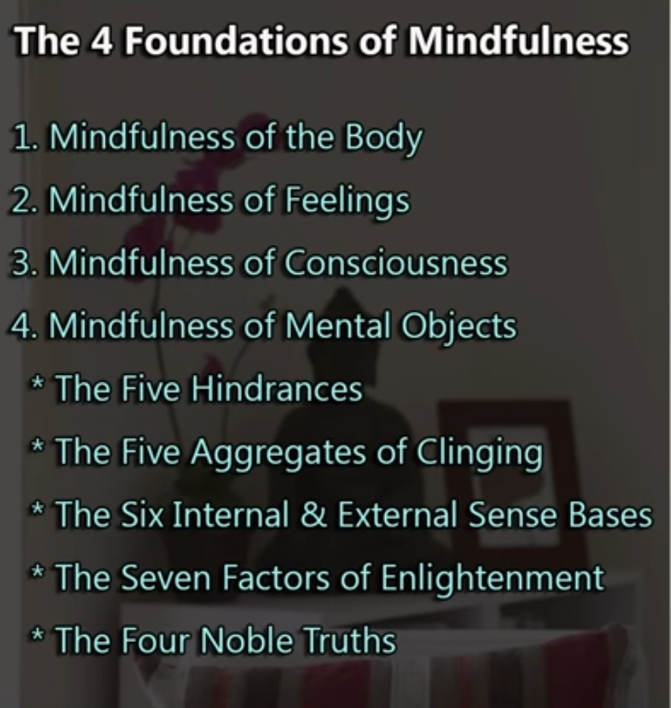

Slide 20
Benefits
Decrease Stress
Enhanced ability to pay attention
Increased quality of life
Reduced symptoms associated with
Depression,
anxiety d/o ,
chronic pain
Insomnia

Slide 21
Increase Concentration
Antidote to Anger
Cultivates Compassion
Gain Freedom and Control
Choice
Space b/w thoughts, emotions,actions

Slide 24
references
1) https://news.harvard.edu/gazette/story/2018/04/less-stress-clearer-thoughts-with-mindfulness-meditation/
2) https://www.ncbi.nlm.nih.gov/pmc/articles/PMC3679190/
3) https://www.pnas.org/content/109/26/10570
4) https://www.pnas.org/content/109/26/10570

