Slide 1
Fiji College of General Practitioner (FCGP) Update from MoHMS
Hon Dr Ifereimi Waqainabete
Minister for Health and Medical Service
Sunday 28 November 2021
Notes:
This presentation is for internal use and is not for public consumption! The information contained within this presentation is strictly confidential.

Slide 2
COVID-19 Update – Global and Regional
Total cases 260,259,160
Total cases
380,226
Total recoveries
294,898 (78%)
Total deaths
4,441 (1.2%)
Total deaths 5,198,464 (2%)
Total recoveries 235,228,702 (98%)
GLOBAL STATS - @26/11/21
REGIONAL STATS - @26/11/21

Slide 3
COVID-19 Update - Fiji
First Wave – 1st case on 19 March 2020
Lasted 30 days, 70 cases, 2 deaths
Second Wave – 1st Case on 18 April 2021
Driven by Delta variant
225 days (32 weeks) @ 28 Nov 2021
Indicators for hospital admissions, deaths, and new cases continue to decline

Slide 4
COVID-19 Update - Fiji
52,494
Total cases
50,991
Recoveries
2020
Total active cases
1.3%
Test positivity rate
696
Total deaths
459,815
Total tests
As of 26 November 2021

Slide 5
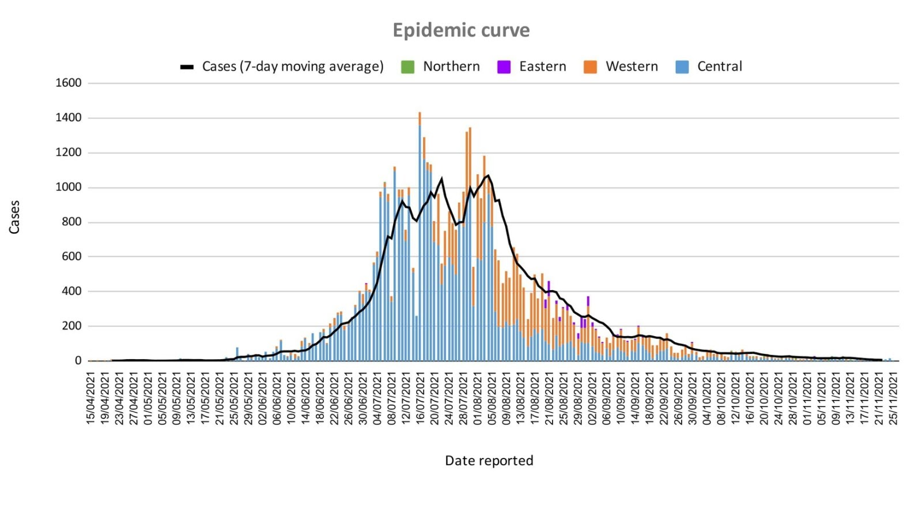
COVID-19 Update - Fiji
As of 26 November 2021

Slide 6
Response Pillars
1. Surveillance & Screening
Symptomatic and laboratory surveillance in place. A comprehensive surveillance program now in place that includes EWARS (ILI, ARI), event based surveillance and community testing surveillance.
2. Testing
6 testing labs in public hospitals and more coming up in private sector. No more testing backlog and testing can do 3 per 1000 pop to 5 per 1000 as during the Mitigation phase.
3. Containment
Targeted lockdowns and curfews assist in stemming the spread of the virus. are working. Quarantine requirements still in place for inbound travellers and home isolation for medical indications.

Slide 7
Response Pillars
4. Treatment
This is being done well with use of evidence-based practice; equipment and resources continuing to arrive
5. Non Pharmaceutical Intervention (NPI) & COVID Safe Measures
Masking, Hand Washing, Physical Distancing, Curfew, Movement restrictions, lockdown, and limitation on mass gatherings.
6. Vaccinations
More than 1.2 million doses of vaccines – AstraZeneca, Moderna, and Pfizer, jabbed into arms to date. No cases of severe Adverse Reactions confirmed.

Slide 8
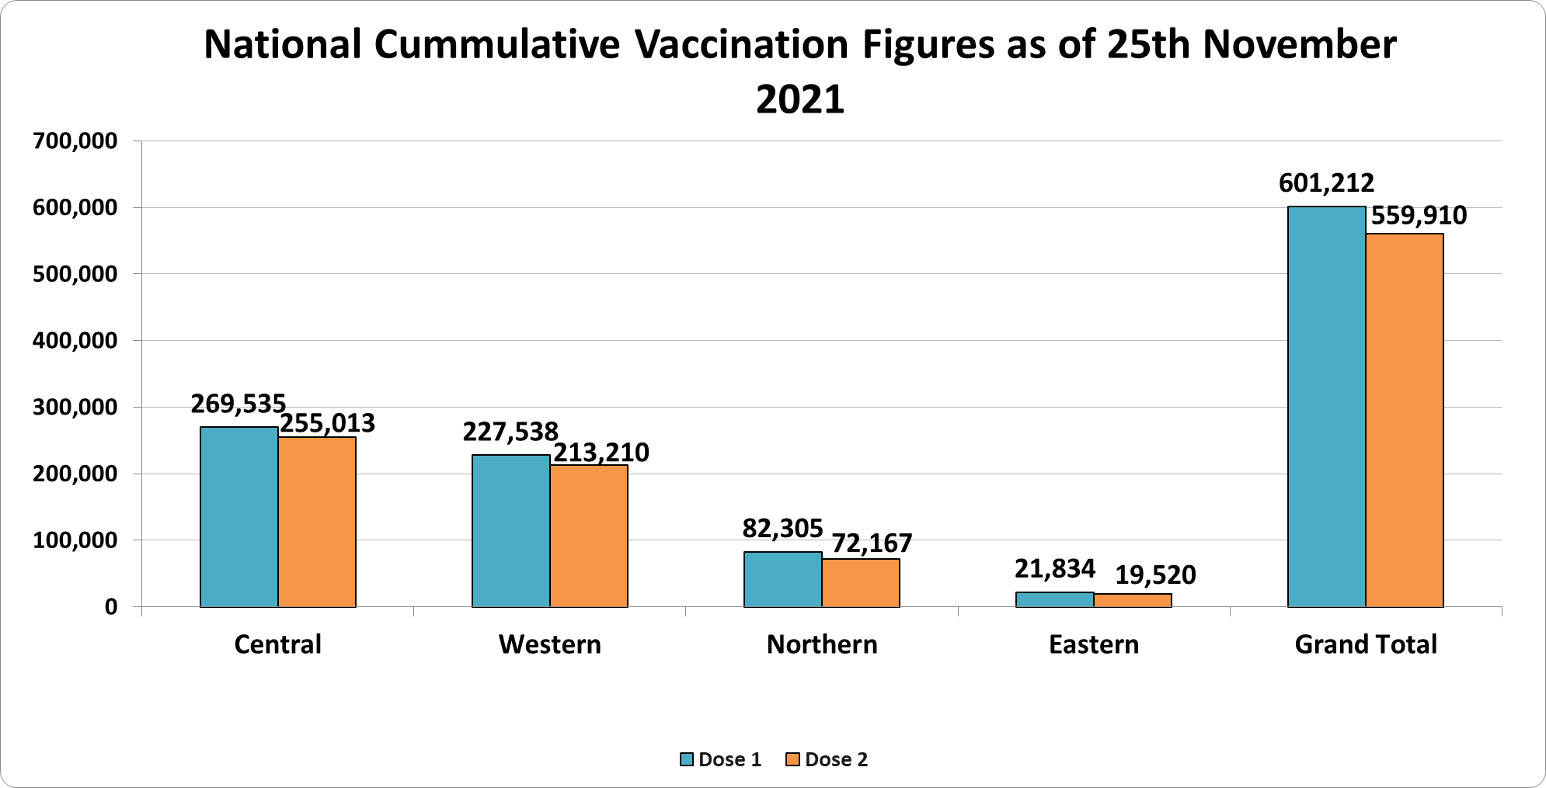
COVID-19 Vaccination Update

Slide 9
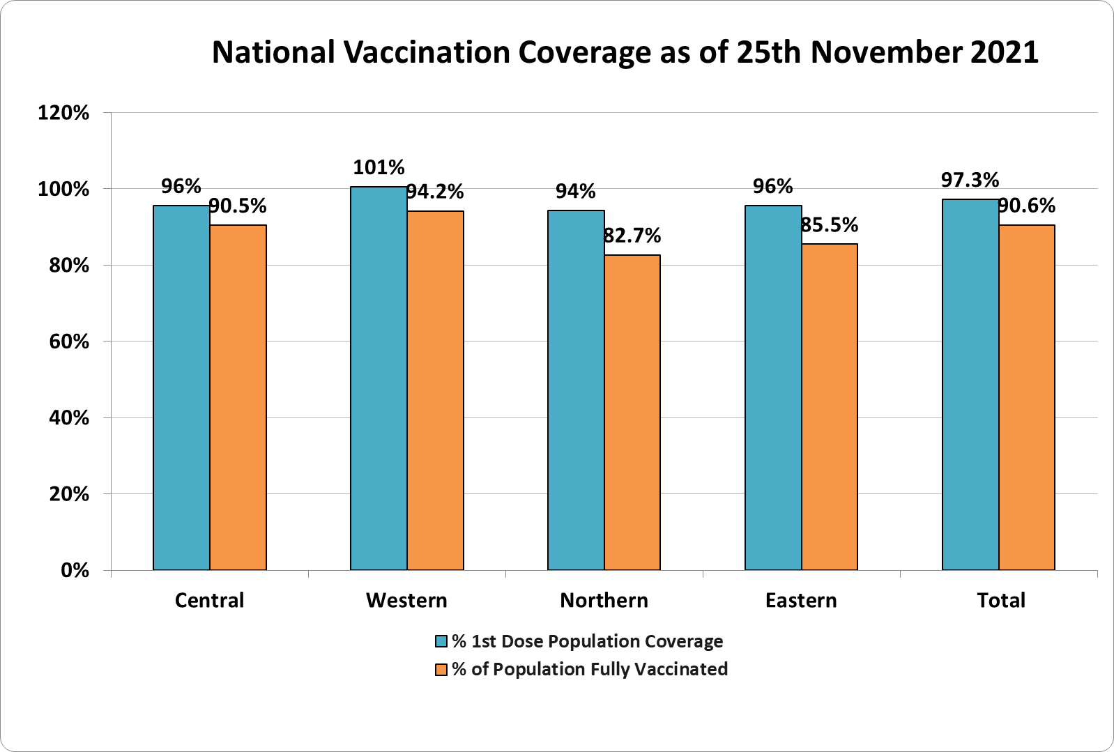
COVID-19 Vaccination Update

Slide 10
COVID-19 Vaccination Update

Slide 11
COVID-19 Vaccination Update

Slide 12
COVID Response: Tackling a New Disease
Brand new disease – never been seen in humans before
No previous experience
No specific treatment or vaccine
Learned from the experience of other on how it behaves
- natural history
- clinical characteristics,
- prevention & public health measures
- treatment
- complications
One in 100 years event – learn and adapt as we go on

Slide 13
COVID Response: Challenges in Mounting a Response
Preparing the population to a new disease – uncertainty & fear
Rapid evolution at the start of the pandemic – challenge to disseminate, educate, keep the team & public in pace
Wide ranging, non-health impact
Gathering multi-sectoral support and ownership
Resistance and opposition – conspiracy theories, vaccine hesitancy and anti-vaxxers, alternative treatment

Slide 14
COVID Response: New approaches
Immigration cards – introduce the medical declaration card on arrival
Closure of international border – against WHO advice
Establish in-country testing capability
Admission of close contacts into Isolation facility
Use WHO’s IMT approach for the first time – set up the operations centre at HQ with General Manager, Chief Operations Officer, 6 pillars, reps from other ministries & agencies

Slide 15
COVID Response: New approaches
Discipline forces joining and leading teams for contact tracings, quarantine, isolation services
Community Engagement pillar – added to IMT as a pillar during the 2nd wave

Slide 16
COVID Response: Changed approaches
High level – whole of ministry changes
Change from EPICOR to M-Supply information system for purchasing and supply chain management of medicines & consumables
Reform service delivery to decentralize service delivery
Change use of FEMAT capability
Lockdown to containment

Slide 17
COVID Response: Changed approach
Operational level changes
As we change phases from elimination to containment to mitigation – major activities points also changed e.g. Telehealth, Intermediate Admission facility,
Fever clinic to Screening clinic
Testing strategy changes – mass to selective testing
Admission and Discharge criteria changes – as new information are known
Drive-thru testing and vaccination – trial that worked!

Slide 18
CSO Engagement in COVID-19 Outbreak Response
Response areas supported by CSO
Telehealth and Telemedicine – working with Telecom Co. & MoH
Clinical Care Pathway – support clinical teams with data mngt and non-clinical roles
Contact tracing and swabbing – interviews, info mngt
Psychosocial Support – working with health partners
Blood Donation Drives – with hospitals’ blood service teams
Donations – organizing drives and distribution

Slide 19
CSO Engagement in COVID-19 Outbreak Response
Response areas supported by CSO
Registration for Vaccination – data entry, data verification, communications, community engagement
Information Management – at command centres
Community awareness – with divisional teams
Ration distribution – with Divisional Commissioners teams, setting up community gardens/food source
Communications & Community Engagement – with MHMS Risk Comms & Community Engagement teams

Slide 20
CSO Engagement in COVID-19 Outbreak Response
Response areas led by CSO
Communications – awareness and to tackle misinformation and stigma
PPE – distribution to the community
Vaccination – support the campaign
Ration distribution – for vulnerable communities
Home garden – with MoA for seedlings and home garden
WASH – distribution to vulnerable communities
Counselling – psychosocial and mental health support

Slide 21
Border Health Protection Unit
With border reopening on 01 Dec 2021, need to ensure that border measures remain in place and enforced to protect against re-introduction of virus from abroad into Fiji
Hence the need to establish a Border Health Unit under the Health Protection division
Objectives of BHPU:
1. Establish processes for the seamless and timely processing of approved visitors to Fiji at all international ports of entry;
2. Facilitate interagency collaboration and cooperation for the health clearance at the international ports of entry for all visitors to Fiji;

Slide 22
Border Health Protection Unit
3. Undertake clinical assessment and inpatient care for visitors suspected or confirmed to be suffering from an imported communicable disease that can be spread within the population in Fiji;
4. Admit, manage and discharge visitors at the designated government quarantine facilities for the purpose of managing the risks of importing communicable diseases into the Fijian communities;
5. Implement all planned border health activities to monitor, report and control the presence of an imported communicable disease amongst visitors to Fiji.

Slide 23
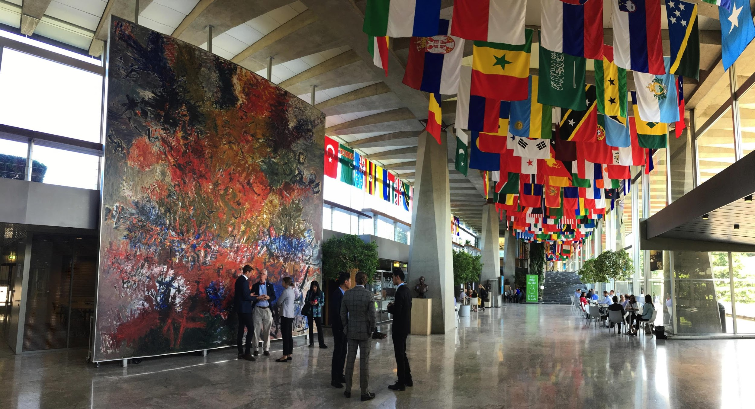
Establishment of the National Surgical, Obstetric, and Anaesthesia Plan (NSOAP)

Slide 24
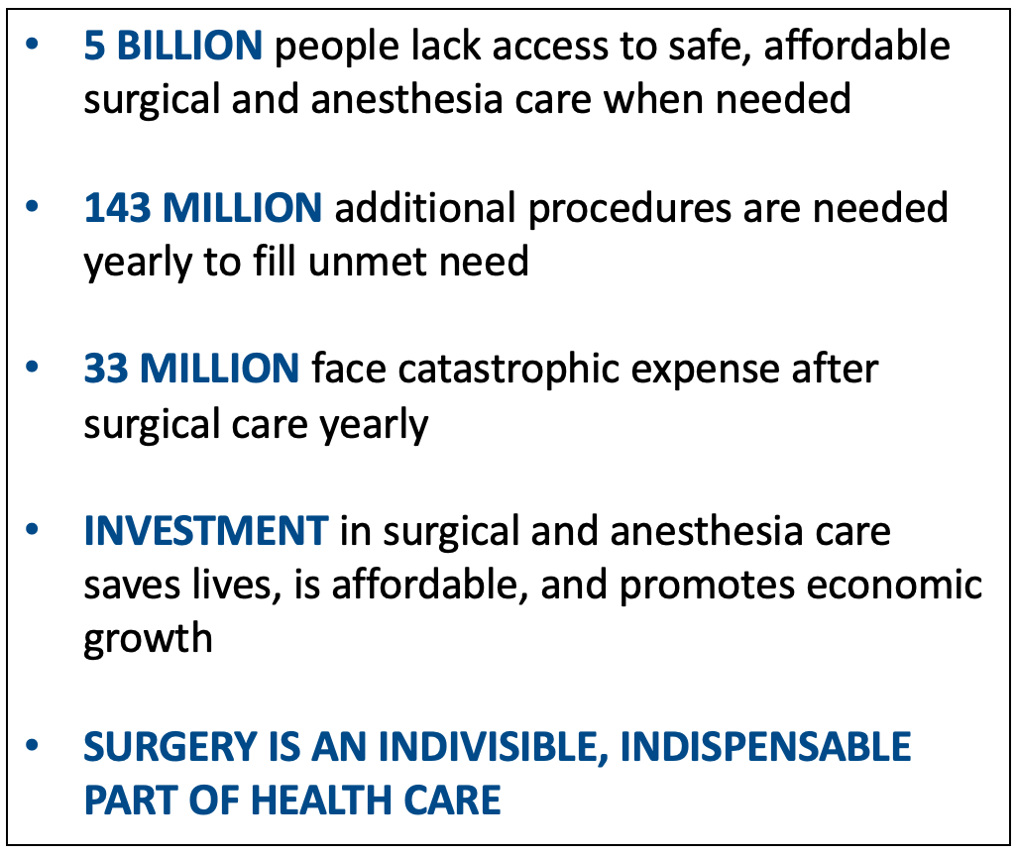
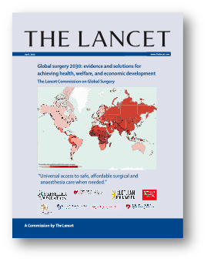
The Lancet Commission on Global Surgery
The reason:
To address the unmet surgical need
Strengthening surgical care also improves health system
ZAMBIA

Slide 25
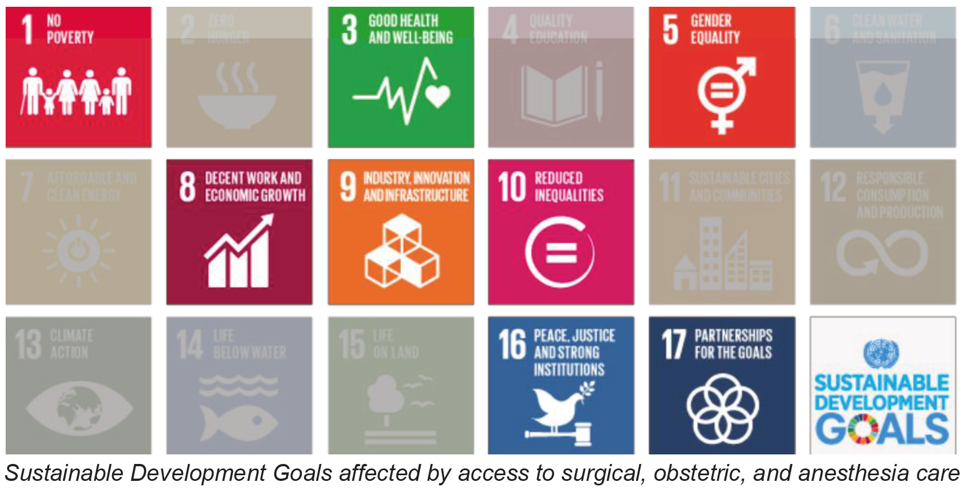
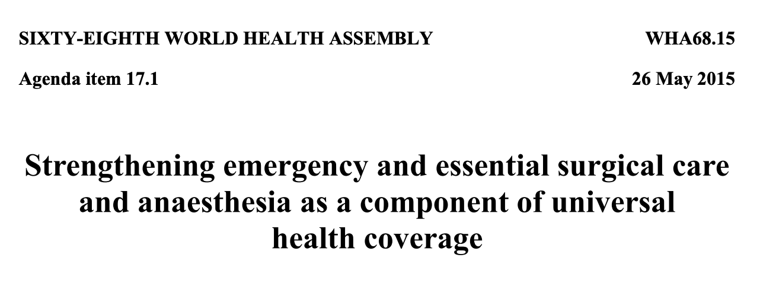
Rationale for NSOAP
Sustainable Development Goals
Surgery can help achieve 8 of the 17 SDGs
Universal Health Coverage
WHA Resolution 68.15 in 2015 – a global priority
Investment is cost-effective
Investment of 350 billion USD needed to meet global surgical needs by 2030
Investing in Surgical Care
is affordable, saves lives, and promotes economic growth
Estimated loss of economic output in LMICs 2015-2030: $12.3 trillion (2010 US $, PPP)
ZAMBIA

Slide 26
Fiji Stats
Indicator | 2030 target | 2015-6 Status | 2020 Status
1. Access to timely essential surgery | 80% | 67% | NA
2. Specialist surgical workforce density per 100,000 people | 20 | 5.8 | 8.2
3. Surgical volume per 100 000 population per year | 5,000 | 1,490 | 2,241
4. Prospective monitoring of Peri-operative mortality | Yes | No | No
5. % risk of catastrophic out-of-pocket expenditure (OOP) | 0% | 21% | NA
6. % risk of impoverishment due to OOP | 0% | 24% | NA
.
ZAMBIA

Slide 27
Pacific Island Countries Surgical System Strengthening
Regional NSOAP considerations
Small populations and economies
Poor access to global markets
Geographical challenges
Climate change
COVID-19
Collaborative approach
Pooling resources
Greater political leverage
Strategic purchasing / supply chain management
Workforce training and distribution
Disaster and pandemic preparedness
Fiji’s progress currently stalled by the pandemic and will resume soon
Fiji
Vanuatu
Tonga
Cook Islands
Palau
ZAMBIA

Slide 28
Climate Resilience and Environmentally Friendly HCFs
What does a “Climate Resilient and Environmentally Sustainable” health care facility (HFC) means?
HFC is able to:
- anticipate,
- respond to,
- cope with,
- recover from, and
- adapt to climate-related shocks and stresses,…..
provide ongoing and sustained health care and protect the health and well-being of future generations

Slide 29
Climate Resilience and Environmentally Friendly HCFs
A guide for climate-resilient and environmentally sustainable health care facilities;
Explains green & environmentally sustainable options
A tool for health workers to be environmentally conscious
A performance based, bench marking document to recognize greening efforts; and
A self-certifying toolkit to help measure improvements in climate resiliency and environmental sustainability.
To create climate resilience and reduce the environmental footprint!

Slide 30
Why the Guideline?
A guide for climate-resilient and environmentally sustainable health care facilities;
Explains green & environmentally sustainable options
A tool for health workers to be environmentally conscious
A performance based, bench marking document to recognize greening efforts; and
A self-certifying toolkit to help measure improvements in climate resiliency and environmental sustainability.
To create climate resilience and reduce the environmental footprint!

Slide 31
Guideline Development ….
Multi-stakeholder consultation
WHO Guideline as base document
Climate Change and Health Strategic Action Plan (CCHSAP) 2016 -2020
WHO expertise input
Health-centric to ensure special needs and functions of HCF are considered
Fiji context

Slide 32
Ten Domains within the 4 prerequisites….

Slide 33
Guideline on Climate Resilient and Environmentally Sustainable Health Care Facilities in Fiji - CRESHCF

